Slide 1
Welcome to AJAX
Tim Wingfield
Notes:
WTF is AJAX?
ASP.Net AJAX
Update panels
Call backs
jQuery FTW!
About me
Live in Hilliard, OH
Wife, two boys, and a black lab

Slide 2

Notes:
Love hockey, especially this guy…pay a lot to see him, at least.

Slide 3



Notes:
Professionally, I work for Quick Solutions, even though none of these people do.
Been with Quick for four years, all in the App Dev Group started by BHP.
Been developing for over 10 years, all in Columbus.

Slide 4
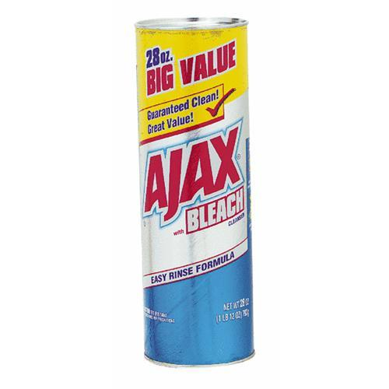
Notes:
“What is AJAX?”
Asynchronous Javascript and XmlHttpRequest
Asynchronous page updates have been around since the Iframe was introduced by IE in ‘96.
MSXML introduced with with IE 4.
‘99 XMLHttpRequest object came around.
Term AJAX coined in ‘05
‘06 W3C created an official AJAX web standard
Browsers have come a long way in AJAX support over the last few years
The term has come to encompass anything that makes the client side wicked cool
Use XMLHttpRequest
Javascript
Update the DOM

Slide 5

Notes:
“Why AJAX?”
Standard web user.
[click]
User experiencing a site using AJAX.
The big one: Better user experience
Reduce postbacks or page refreshes
Partial rendering can improve performance
Large pieces of the page – images, scripts, style sheets – can be loaded once

Slide 6

Notes:
Disadvantages
Heavy Javascript usage – if scripts are turned off or old browser, no AJAXy fun for that user
Lose some Back Button support (though this is coming around)
Mobile device support lacking

Slide 7

Notes:
How’d we get here?
Atlas project unveiled at PDC in Sept 05
Released as stand-alone extension for asp.net 2.0 in Jan 07
adds System.Web.Extensions
Available out of the box in .net 3.5
A bit different from traditional js AJAX libraries because of the server side components

Slide 8
<asp:ScriptManager
ID=“ScriptManager1”
runat=“server”
EnablePartialRendering=“true”
EnablePageMethods=“false”
AsyncPostBackTimeOut=“90”
/>
Notes:
Script Manager does the magic.
Links the .js files in
Add to master page
Partial rendering – “Atlas” was set to false by default. Magic needed for update panels to work asynchronously
Page methods – allows static methods to be written in the code behind. Decorate with [WebMethod] attribute
Async timeout – will use here later. Allows for longer/shorter timeouts depending on your situation
AsyncPostBackErrorMessage - Async error message – catch all message. Quick and dirty way to clean up error messages.
Scripts collection – allows you to register js scripts to the page. The script manager will register during the page’s PreRender event
Services collection – allows you to register web services for use in call-backs. Also during the PreRender event.

Slide 9
<asp:UpdatePanel ID=“UpdatePanel1” runat=“server”
ChildrenAsTriggers=“true”
UpdateMode=“Always”
RenderMode=“Block”
>
Notes:
Update Panel, automates the AJAXing of your pages
ChildrenAsTriggers=false and UpdateMode=Always throws and InvalidOperation error
UpdateMode=always – updates every postback on the page
UpdateMode=Conditional – Updates on update() method call (server or client), from triggers in the trigger collection, and ChildrenAsTriggers=True
RenderMode – block or inline, renders as a div or span
Pros
Quick and Easy
Makes most ASP.Net controls AJAX enabled out of the box
Adding to a data grid can make paging and sorting a much better UX
Can add update progress controls to signify something going on
Cons
Full page life-cycle every time
Can only handle one event at a time to keep viewstate straight
No default user feedback of async postback
Extra work for error handling
requires client script
Not suited for larger implementations
Multiple panels can present some code management problems.
Update mode
Child triggers and trigger collection
Focus issues as whole panel is refreshed

Slide 10

Page Request Manager
Notes:
Manages the partial-page updates of Update Panels
Partial Page Rendering must be true
One instance per page
You don’t create the page request manager, rather get the instance of it.
If one update panel is on the page with partial rendering enabled, the script manager registers the prm script

Slide 11
Page Request Manager Client Events
initializeRequest
beginRequest
pageLoading
pageLoaded
endRequest
Notes:
initReq - Raised before processing of the asynchronous request starts. You can use this event to cancel a postback.
begReq - Raised before processing of an asynchronous postback starts and the postback is sent to the server. You can use this event to set request headers or to begin an animation that indicates that the page is processing.
pageLoading - Raised after the response from the server to an asynchronous postback is received but before any content on the page is updated.
pageLoaded - Raised after all content on the page is refreshed. You can use this event to provide a custom transition effect for updated content.
endReq - Raised after an asynchronous postback is finished and control has been returned to the browser. You can use this event to provide a notification to users or to log errors.
<Go to all update panel code here>

Slide 12

AJAX Control Toolkit
Notes:
Shared source project through Microsoft
Been around since early in beta testing of atlas
34 controls at the moment
Download and copy dll into bin to use
Quickly and easily make a better UX
Extender available to create your own controls

Slide 13
<code />
Notes:
New app
Demo app

Slide 14

Javascript Callbacks
Notes:
Closer to the other ajax js libraries
Async callbacks to web services
Use public services on the net
Use local services, wcf, asmx
Call page methods in aspx codebehinds decorate with [WebMethod], include scriptservice
JSON
Can return strongly typed objects
Fully qualified on client
Pros
Lightweight and quick – kachow!
No page lifecycle involved
Reuse via web services
Cons
Not drag and drop “easy” like update panels
Heavy client script
More difficult debugging
Response is always a string. Large data can defeat the purpose of using the client.
Multiple callbacks can get messy
All handled by RaiseCallbackEvent
If more than one call comes in, GetCallBackEventReference is needed, which will in turn be handled by RaiseCallbackEvent

Slide 15
<code />
Notes:
New app
Demo app

Slide 16

Notes:
Lightweight, easy to use javascript library founded by John Resig
Microsoft announced support of jQuery in Visual Studio on Sept 28.
AJAXy callbacks not quite as easy as with asp.net ajax
Can be used in conjunction with asp.net ajax

Slide 17
<code />
Notes:
New app
Demo app

Slide 18
Resources
Microsoft AJAX libraries: ajax.asp.net
jQuery: jquery.com
Toolkit: asp.net/ajax/ajaxcontroltoolkit/
Scott Guthrie: weblogs.asp.net/scottgu/
Matt Berseth: mattberseth.com
Notes:
Microsoft link has the documentation and the forums
Toolkit has a running sample, and you get the source and sample with the download
Scott Guthrie will have a link wrap-up every few weeks with some great AJAX stuff in addition to his own. A few of the links are to…
Matt Berseth’s blog. Matt is doing some fun stuff with the toolkit.

Slide 19
Tim Wingfield
Email: tim@timwingfield.com
Blog: blog.timwingfield.com
Twitter: timwingfield
Code and Slides: code.google.com/p/codeincubator/source/browse/Samples/Intro-to-asp.net-ajax
Notes:
Questions?

